Slide 1


Faculty of Computing and Informatics
Business Management Information Systems – BMC511S-
Lesson 5 – IT infrastructure and emerging technologies

Slide 2
Faculty of Computing and Informatics
IT infrastructure and emerging technologies
An introduction to IT infrastructure
The connection between a firm, IT infrastructure and business capabilities
Components of IT infrastructure
Emerging technologies – cloud computing
Challenges of managing IT infrastructure
Total Cost of Ownership model
Competitive Forces Model for IT infrastructure

Slide 3
Faculty of Computing and Informatics
An introduction to IT infrastructure
IT infrastructure is the shared technology resources that provide the platform for an organisation’s specific information systems application
IT infrastructure includes investment in hardware, software and services – such as consulting, education and training that are shared across the entire organisation or business unit in an organisation
The services provided through IT infrastructure include the following:
  Computing platforms used to provide computing services that connect employees, customers and suppliers
  Telecommunications services that provide data, voice and video connectivity to employees, customers and suppliers
  Data management services that store and manage corporate data and provide capabilities for analyzing the data

Slide 4
Faculty of Computing and Informatics
An introduction to IT infrastructure
The services provided through IT infrastructure include the following:
-Application software services such as enterprise resource planning (ERP), customer relationship management (CRM), supply chain management and knowledge management systems that are shared by all business units
- Physical facilities management services that develop and manage the physical installations required for computing, telecoms and data management services
- IT management services that plan and develop infrastructure, coordinate with the business units for IT services, manage accounting for the IT expenditure and provide project management services

Slide 5
Faculty of Computing and Informatics
An introduction to IT infrastructure
The services provided through IT infrastructure include the following:
-IT standards and services that provide the organisation and its business units with policies that determine which information technology will be used
-IT education services that provide training in systems use to employees and offer managers training on how to plan for and manage IT investment
- IT research and development services that provide an organisation with research on potential future IT projects and investments that could help the organisation differentiate itself in the market place

Slide 6
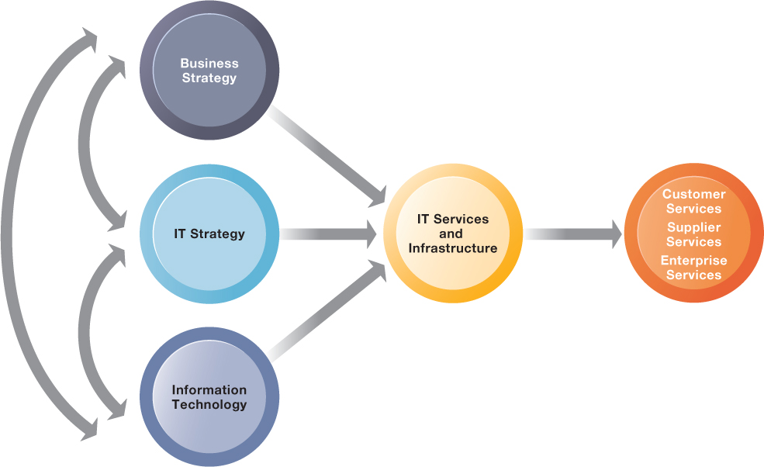
Faculty of Computing and Informatics
Connection between an organisation, IT infrastructure and business capabilities
The service a firm is capable of providing to its customers, suppliers and employees are a direct function of its IT infrastructure
The infrastructure should support the organisation’s business and IS strategy

Slide 7
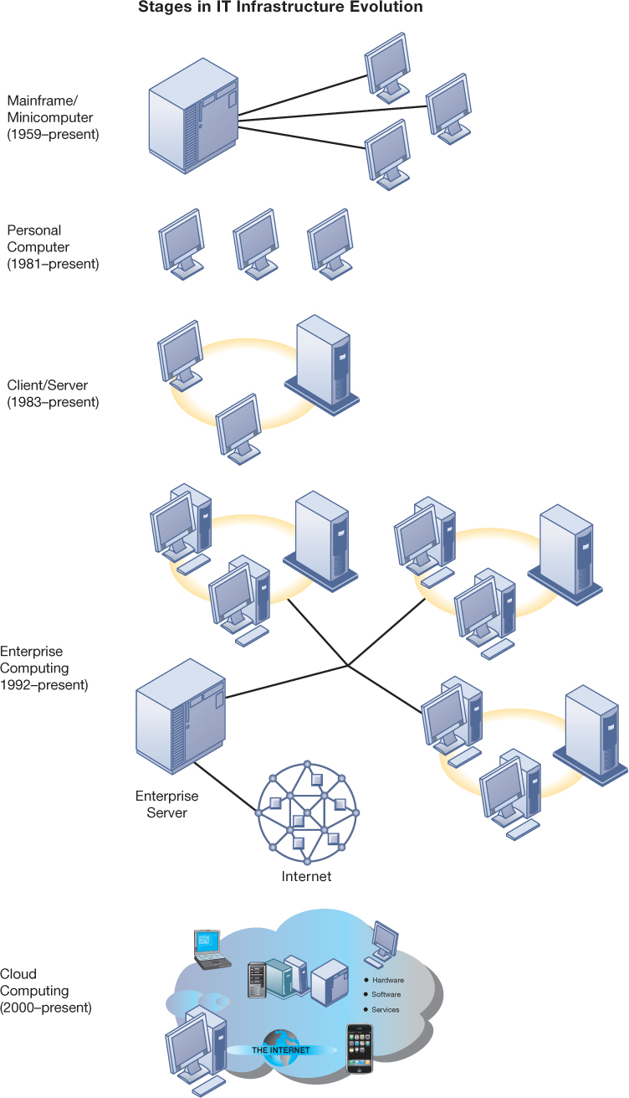

Slide 9
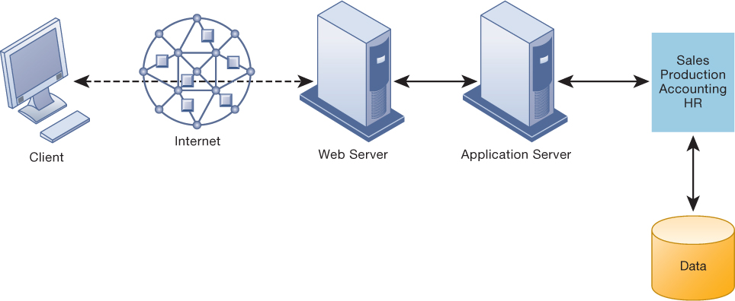

Slide 10
A Multitiered (N-Tier) Client/Server Network

Slide 11
Faculty of Computing and Informatics
Components of IT infrastructure
The services provided through IT infrastructure include the following:
Computer hardware platforms – the collection of the physical parts of a computer, e.g. Dell, IBM, Apple, HP
Operating systems – the software that manages resources and activities of a computer such as sharing internal memory among applications, handling input/output operations, multitasking of programs, e.g. Unix, Linux, Chrome, Android, iOS, mac OSX
Enterprise software applications - computer software to satisfy the enterprise needs of an organisation such as digital content creation, collaboration, ERP, CRM, e.g. SAP, Oracle, Microsoft
Networking/Telecommunications – telecommunications / telephone services that offer voice and data connectivity, wide area networking, wireless services and internet access, e.g. Linux, CISCO, Alcatel-Lucent, AT&T, Verizon

Slide 12
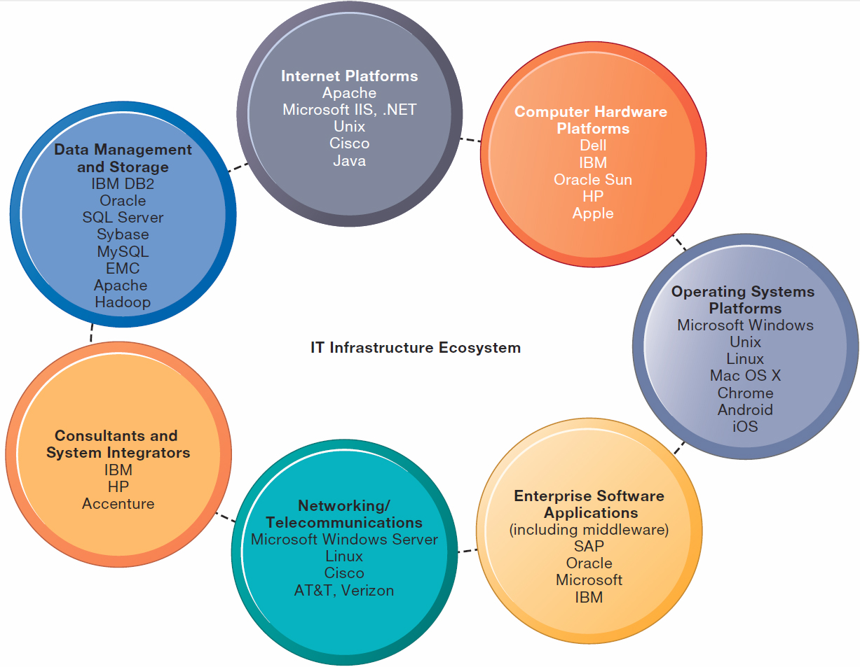
The I T Infrastructure Ecosystem

Slide 13
Faculty of Computing and Informatics
Components of IT infrastructure
The services provided through IT infrastructure include the following:
Consultators and system integrators – implementing new infrastructure and ensuring it works with an organisation’s older legacy systems, e.g., IBM, HP, Accenture
Database management and storage – for organizing and managing an organisation’s data so that they can be efficiently accessed and used, e.g. IBM DB2, Oracle, SQL Server, MySQL, Apache, Hadoop, EMC
Internet platforms – hardware, software and management services to support an organisation’s web site, web hosting services, routing, cabling or wireless, e.g. Apache, Microsoft IIS, .NET, Unix, Cisco, Java

Slide 14
Faculty of Computing and Informatics
Emerging technologies – Cloud computing
Cloud computing is a model of computing in which computer processing, storage, software and other services are provided by a pool of virtualized resources over a network
There are 3 different types of services offered through the cloud
  Infrastructure-as-a-service (IaaS) – customers use processing, storage, networking and other computing resources from cloud service providers to run their information systems, e.g. Simple Storage Service (S3), Elastic Computer Cloud (EC2)
  Platform-as-a-service (PaaS) – customers use infrastructure and programming tools supported by the cloud service provider to develop their own applications, e.g., IBM’s Smart Business Application Development and test Service for software development, Salesforce.com
  Software-as-a-Service (SaaS) – customers use software hosted by the vendor on the vendor’s cloud infrastructure and delivered over a network, e.g. Google Apps, salesforce.com

Slide 15
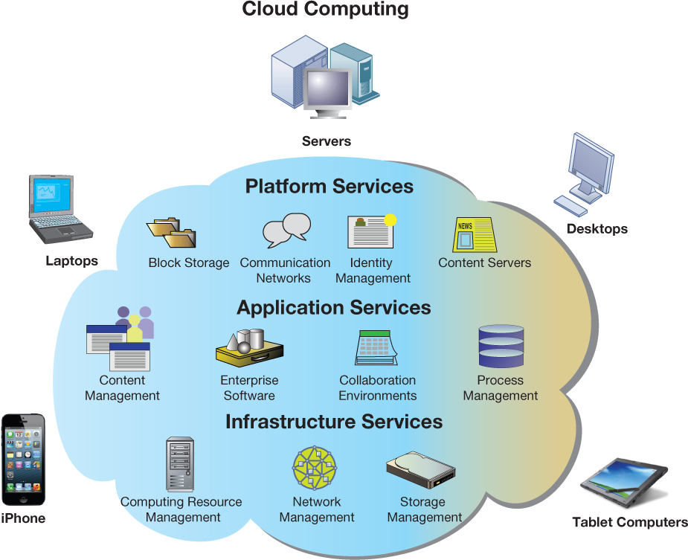
Cloud Computing Platform

Slide 16
Faculty of Computing and Informatics
Emerging technologies – characteristics of cloud computing
Cloud computing has the following characteristics
  On-demand self-service – consumers can obtain computing capabilities such as server time or network storage as needed automatically on their own
  Ubiquitous network access – cloud services can accessed by using standard network and internet devices, including mobile platforms
  Location-independent resource pooling – computing resources are pooled to serve multiple users, with different virtual resources dynamically assigned according to user demand
  Rapid elasticity – computing resources can be rapidly provisioned, increased or decreased to meet changing user demands
  Measured services – charges for cloud resources are based on the amount of resources actually used.

Slide 17
Faculty of Computing and Informatics
Challenges of managing IT infrastructure
The challenges of managing IT infrastructure are as follows:
  Dealing with platform and infrastructure change – As firms grow, they outgrow their infrastructure. As they shrink, they can get stuck with excessive infrastructure
  Scalability – the ability of a computer, product or system to expand to serve a large number of users without breaking down. New applications, new acquisitions and changes in business volume all impact on computer workload
  Management and governance - Who manages the IT infrastructure in an organisation and how will infrastructure be allocated among business units?
  Ownership of infrastructure – Should a firm purchase and maintain its own infrastructure, or rent from external suppliers?
  Spending on infrastructure – if too little is spent, important business services cannot be delivered and the organisation’s competitors will outperform . If a lot is spent on the infrastructure, it lies idle and constitutes a drag on finances

Slide 18
Faculty of Computing and Informatics
Components of the Total Cost of Ownership (TCO) model
TCO is an analysis of direct and indirect costs that help a firm determine the actual cost of the specific technology implementation
The components of TCO are:
  Hardware acquisition – purchase price of hardware equipment including computers, storage, printers
  Software acquisition – purchase or licence of software for each user
  Training – cost to provide training for information systems specialists and end users
  Support – cost to provide ongoing technical support, help-desks and so forth

Slide 19
Faculty of Computing and Informatics
Components of the Total Cost of Ownership (TCO) model
The components of TCO are:
  Maintenance – cost to upgrade the hardware and software
  Infrastructure – cost to acquire , maintain and support related infrastructure, such as networks and specialized equipment including storage back-up units
  Downtime – cost of lost productivity if hardware or software failures cause the system to be unavailable for processing and user tasks
  Space and energy – real estate and utility costs for housing or providing power for the technology

Slide 20
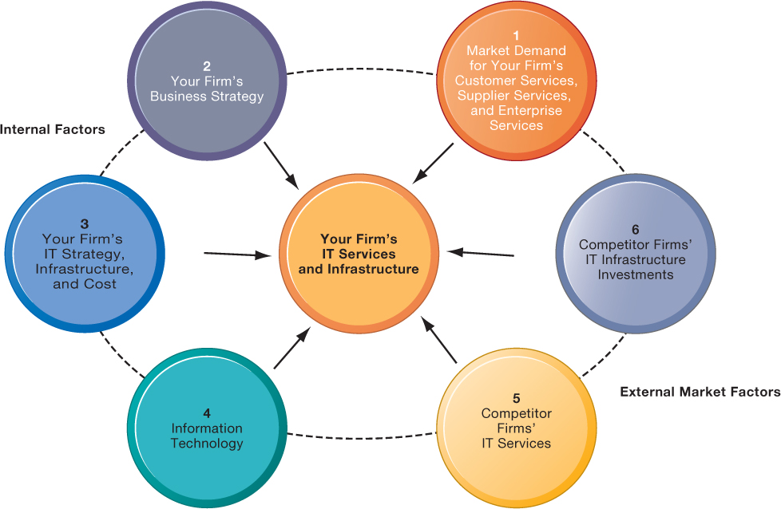
Faculty of Computing and Informatics
Competitive Forces Model for IT Infrastructure Investment
How much should a firm spend on infrastructure?

Slide 21
Faculty of Computing and Informatics
Competitive Forces Model for IT Infrastructure Investment
The components of the model are:
  Market demand for an organisation’s services – do a market analysis, e.g., are the services you offer meeting the needs of customers?; are customers complaining of slow response to queries?
  Your organisation’s business strategy – Assess your business strategy and identify what new services and capabilities are required to achieve strategic goals
  Your organisation’s IT strategy, infrastructure and costs – conduct a TCO analysis to ensure that your IT plans for the next 5 years are aligned to your business plans

Slide 22
Faculty of Computing and Informatics
Competitive Forces Model for IT Infrastructure Investment
The components of the model are:
  IT assessment – do not be behind the technology curve or at the bleeding edge of IT. Do not spend on advanced experimental and often expensive technology. Do not lag behind
  Competitor organisation services – Assess what technology services competitors offer to customers, suppliers and employees for comparison towards a competitive environment
  Competitor organisation IT infrastructure investments - Benchmark your expenditure on IT infrastructure against your competitors

